Slide 1

Department of Computer Science and Engineering Mini Project Phase Presentation Course Code: 21CSMP67 Project Title FAKE NEWS DETECTION
VISVESVARAYA TECHNOLOGICAL UNIVERSITY - BELAGAVI
Accredited by NBA
Students Name:
Mr.Mihir.M.Savadi (2BU21CS066)
Mr.Omkar.R.Patil (2BU21CS078)
Mr.Pratham.R.Chougula (2BU21CS088)
Mr.Prathamesh.Y.Jadhav (2BU21CS090)
Guide Name:
Name: Mrs. Sahana Bislapur
Designation:Asst. Professor

Slide 2

Contents
1.Introduction to Fake News Detection
2. Objectives
3. Problem Statement
4.Requirements
5. Machine Learning Techniques for Fake News Detection
6. Feature Engineering for Fake News Datasets
7. Supervised Learning Approaches
8. Unsupervised Learning Techniques
9. Flowchart
10. Evaluation Metrics and Benchmarking
11. Bar Graph
12. Outcomes
13. Challenges and Limitations
14. Conclusion and Future Directions
15. References

Slide 3


Introduction to Fake News Detection

Slide 4
Introduction to Fake News Detection
Fake news has become a pressing issue in the digital age, as the rapid spread of misinformation can have serious consequences. This presentation will explore the use of machine learning techniques to identify and mitigate the impact of fake news.

Slide 5
Literature Review
"Detecting Fake News using Machine Learning: A Systematic Literature Review"¹:
This review discusses the need for machine learning classifiers to automatically detect fake news. It covers various machine learning algorithms and their application in identifying fake news on online platforms. 2102.04458 (arxiv.org)
Keywords: Online fake news, Machine learning, Text Classification, social media.
"A systematic literature review and existing challenges toward fake news detection models"²:
This paper reviews fake news detection models contributed by machine learning and deep learning algorithms. It categorizes and describes fundamental approaches that have been effective in recent years. A systematic literature review and existing challenges toward fake news detection models | Social Network Analysis and Mining (springer.com)
"A comprehensive survey on machine learning approaches for fake news characterization"³:
This extensive review explores previous studies aimed at understanding and combating the dissemination of fake news. It focuses on machine learning and deep learning techniques.
"Fake news detection: a systematic literature review of machine learning algorithms and datasets"⁴:
This review specifically examines machine learning algorithms and datasets used for fake news detection. dblp: Fake news detection: a systematic literature review of machine learning algorithms and datasets.

Slide 6
Problem Statement
Developing effective machine learning models to detect and mitigate the spread of fake news across digital media platforms, ensuring the integrity and trustworthiness of online information.

Slide 7
Objectives
Develop robust machine learning models to accurately detect and classify fake news content across various digital media platforms
Implement effective techniques for mitigating the spread of disinformation and restoring trust in online information sources
Analyze the latest research and best practices in the field of fake news detection to inform the project's approach
Establish reliable and scalable methods for identifying the key characteristics and patterns of fake news articles
Deliver a comprehensive solution that can be seamlessly integrated into existing content moderation workflows

Slide 8
System Requirements
Hardware Requirements:
1. Processor and GPU:
Development/Prototyping: Multi-core CPU
2. Memory (RAM):
Development/Prototyping: At least 16GB of RAM.
3. Storage:
Development/Prototyping: SSD with at least 512GB.
Software Requirements:
1. Programming Languages:
Python 3.7 or later (most commonly used for ML).
2. ML Frameworks and Libraries:
scikit-learn for general-purpose ML algorithms.
pandas and NumPy for data manipulation and numerical computing.
3. Integrated Development Environments (IDEs) and Tools:
- Jupyter Notebook for interactive development and data analysis.

Slide 9


Importance of Fake News Mitigation
1
Preserving Informed Decision-Making
Detecting and debunking fake news is crucial for maintaining a well-informed citizenry and enabling sound decision-making.
2
Combating Manipulation and Polarization
Fake news can be used to manipulate public opinion and exacerbate societal divisions, undermining the foundations of democracy.
3
Safeguarding Credibility of Information
Effective fake news detection helps preserve the integrity and trustworthiness of news sources and media outlets.

Slide 10
Machine Learning Techniques for Fake News Detection
Natural Language Processing
Feature Engineering
Classification Models
Analyzing the linguistic patterns and content of news articles to identify potential indicators of fakeness.
Extracting relevant features from news data, such as source credibility, sentiment, and writing style.
Employing supervised and unsupervised learning algorithms to classify news articles as real or fake.

Slide 11


Feature Engineering for Fake News Datasets
1
Textual Features
Analyzing the content of news articles, including sentiment, readability, and linguistic complexity.
2
Source-based Features
Evaluating the credibility and reputation of the news source, as well as its past accuracy.
3
User Engagement Features
Examining user interactions and engagement patterns, such as shares, comments, and user ratings.

Slide 12

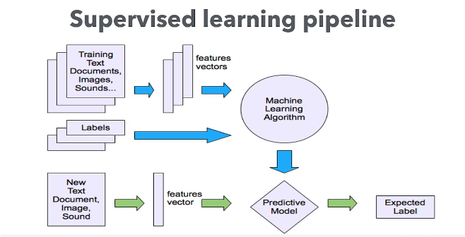
Supervised Learning Approaches
Logistic Regression
A classic model for binary classification tasks, such as identifying fake news articles.
Support Vector Machines
Effective in handling high-dimensional feature spaces and identifying complex decision boundaries.
Decision Trees and Random Forests
Powerful models that can capture non-linear relationships in news article features.
Ensemble Methods
Combining multiple models to leverage their strengths and improve overall performance.

Slide 14

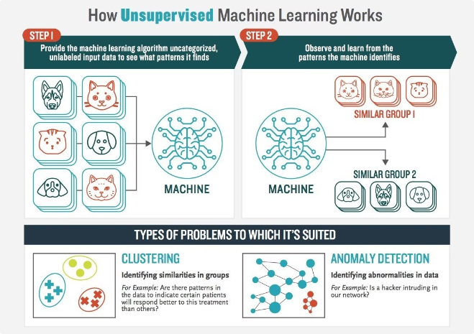
Unsupervised Learning Techniques

Slide 15



Unsupervised Learning Techniques
Clustering
Grouping news articles based on shared characteristics to detect anomalies and outliers.
Anomaly Detection
Identifying news articles that deviate significantly from the norm, potentially indicating fakeness.
Topic Modeling
Discovering latent themes and patterns in news content to uncover potential disinformation campaigns.

Slide 16
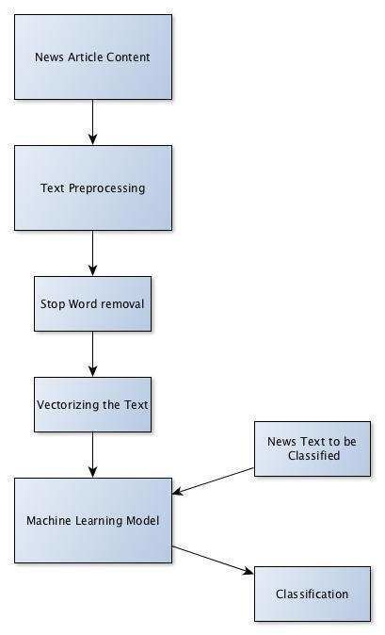
Flowchart:

Slide 17
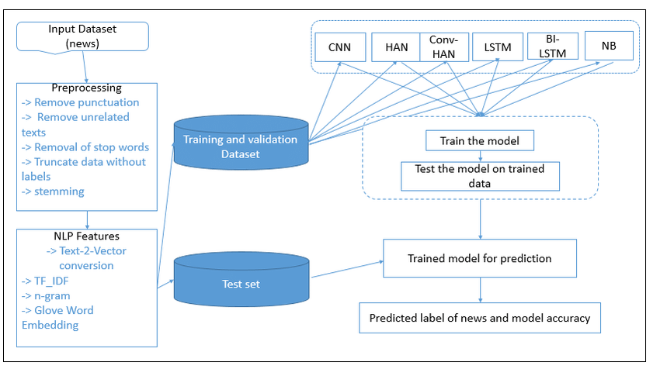
Use case diagram:

Slide 18

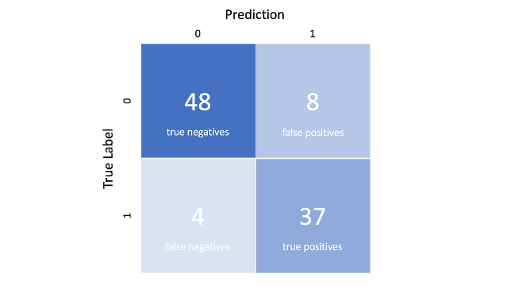
Evaluation Metrics and Benchmarking
Accuracy
Overall correctness of the model's predictions
Proportion of true positives among the positive predictions
Precision
Recall
Proportion of true positives among all actual positive instances
F1-Score
Harmonic mean of precision and recall, balancing the two metrics

Slide 19
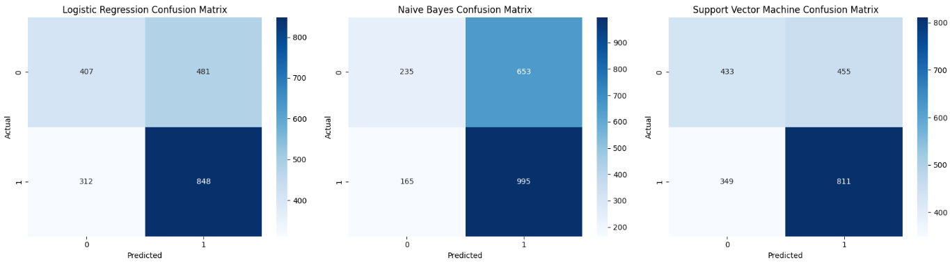
Confusion Matrix

Slide 20
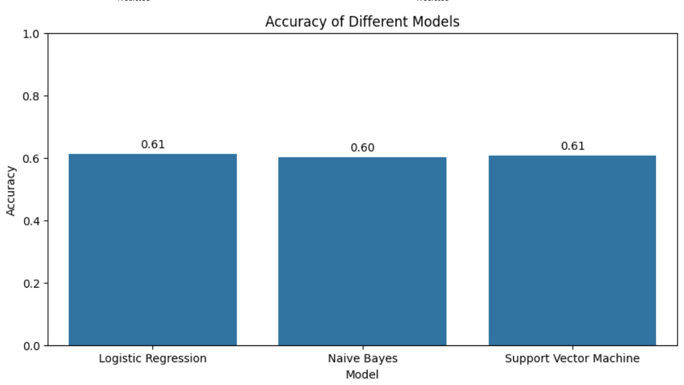
Bar Graph

Slide 21
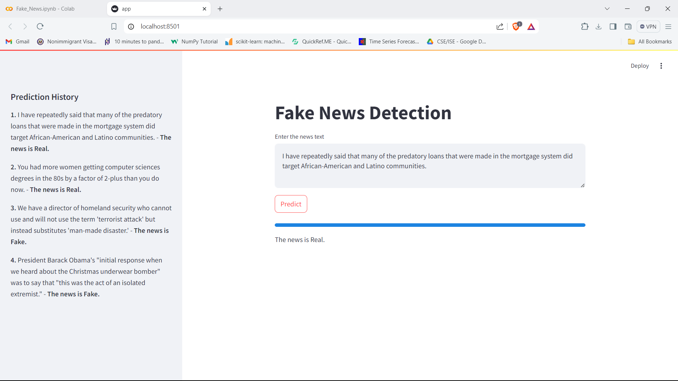
Outcome Snapshot

Slide 22





Challenges and Limitations
Adaptive Fake News
Fake news creators constantly evolve their tactics to evade detection.
Data Scarcity
Obtaining high-quality, labeled datasets for training ML models can be challenging.
Multilingual and Cross-Cultural Considerations
Effective fake news detection must account for diverse linguistic and cultural contexts.

Slide 23


Conclusion and Future Directions
1
Ongoing Research and Innovation
Advancements in ML and NLP will continue to drive improvements in fake news detection.
2
Collaboration and Interdisciplinary Approaches
Combining technical, social, and policy-based solutions is key to addressing fake news.
3
Proactive and Preemptive Strategies
Developing early warning systems and public awareness campaigns can help mitigate the spread of fake news.

Slide 24
References
https://link.springer.com/chapter/10.1007/978-3-319-61845-6_17
https://ieeexplore.ieee.org/document/8580970
https://ieeexplore.ieee.org/document/8721565
https://arxiv.org/abs/1712.05999
https://arxiv.org/abs/1909.01838
https://arxiv.org/abs/2006.02850
https://arxiv.org/abs/1810.04805
https://link.springer.com/article/10.1007/s00500-019-04465-7

Slide 25
THANK YOU

